Slide 1
Business Analysis
AYITI ANALYTICS - Cohort 2021

Slide 2
THE BUSINESS PROBLEM

Slide 3
The business problem
Michel finds himself in a dilemma with his shop more specifically in the field of selling tomato paste. He doesn't know if he should keep selling them or not.
Description

Slide 4
The business problem
Michel
Michel’s son
Customers
Provider
The stakeholders

Slide 5
The business problem
The problem is important because it affects the profitability of the company.
Why the template is important?

Slide 6
THE METHODOLOGY

Slide 7
The Methodology
AVAILABLE DATA
Sales for the 3 month (December, January, February)
Purchase Price
Sales Price
Orders
CALCULATED DATA
Variation of Rate Growth by two weeks.
Buying Quantity by two weeks.
Sales Quantity by Two weeks.
Losses recorded every two weeks.
Delay of Losses absorption.
Ratio benefits/losses.
Benefits improvement due by our recommandation.
Sales prediction.

Slide 8
The Methodology
CALCULATED DATA
1. Variation of Rate Growth by two weeks.
2.Delay of Losses absorption.
3.Ratio benefits/losses.
4.Sales prediction.
1.The weekly rate growth variation allow us to know the trend.
2.Delay off losses absorption allow Michel to know what he can do if he want to absorb those loses.
3.Ratio benefits/losses allow us to know the impact of our losses and will sensibilize Michel to adopt a new method of management.
4.Sales prediction as her name explain, it allow us to do prediction and based on our prediction, he facilitate us to found the right recommandation.

Slide 9
The Methodology
Our calculations of the losses are based on the FIFO method of stock management.
First In First Out.
Whatever the method he used , at the end the losses will be the same.
FIFO

Slide 10
The Methodology
We use a model of means Growth.
Michel gave us the data set. This data set contains several information about the sales .
We calculate the bi-weekly rate of growth and after we take her mean and apply this for the next month.
For our calcul we used GoogleSheets.
Model of Prediction

Slide 11
RESULTS

Slide 12
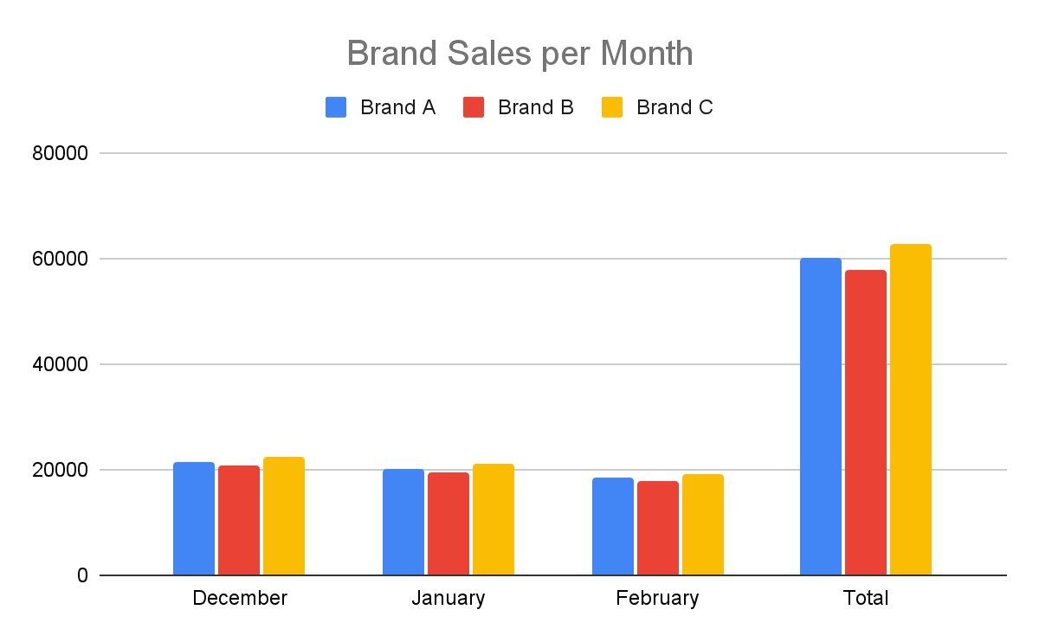
Results
Turnover by Brand and by Month

Slide 13
Results
Calculated loss repartition by week
(For A Brand) ********
Date | Quantity purchased | Quantity Sold | Rest | Losses
12/2/2019 | 840
12/16/2019 | 840 | 398 | 442
12/30/2019 | 840 | 403 | 39 | 39
1/13/2020 | 840 | 359 | 481 | 481
1/27/2020 | 840 | 334 | 506 | 506
2/10/2020 | 840 | 402 | 438 | 438
2/24/2020 | 840 | 365 | 475 | 475
3/9/2020 |  | 148 | 692 | expires in 9 days
3/23/2020 |  |  | 840 | expires in 23 days
Total | 5880 | 2409 |  | 1939

Slide 14
Results
Calculated loss repartition by week
(For B Brand)
Date | Quantity Purchased | Quantity Sold | Rest | Losses
12/2/2019 | 960
12/16/2019 | 960 | 398 | 562
12/30/2019 | 960 | 403 | 159 | 159
1/13/2020 | 960 | 359 | 601 | 601
1/27/2020 | 960 | 334 | 626 | 626
2/10/2020 | 960 | 402 | 558 | 558
2/24/2020 | 960 | 365 | 595 | 595
3/9/2020 |  | 148 | 812 | expires in 9 days
3/23/2020 |  |  | 960 | expires in 23 days
Total | 6720 | 2409 |  | 2539

Slide 15
Results
Calculated loss repartition by week
(For C Brand)
Date | Quantity Purchased | Quantity Sold | Rest | Losses
12/2/2019 | 720
12/16/2019 | 720 | 398 | 322
12/30/2019 | 720 | 403 | -81
1/13/2020 | 720 | 359 | 280 | 280
1/27/2020 | 720 | 334 | 386 | 386
2/10/2020 | 720 | 402 | 318 | 318
2/24/2020 | 720 | 365 | 355 | 355
3/9/2020 |  | 148 | 572 | expires in 9 days
3/23/2020 |  |  | 720 | expires in 23 days
Total | 5040 | 2409 |  | 1339

Slide 16
Results
Sales Prediction | Brand A | Brand C | Brand B | Total
Sales Prediction in 9 Days | 213 | 213 | 213 | 639
Sales Prediction in next 15 days | 357 | 357 | 357 | 1071
Total Sales Prediction for the next Month | 570 | 570 | 570 | 1710
Last lost | 962 | 722 | 1202 | 2886

Slide 17
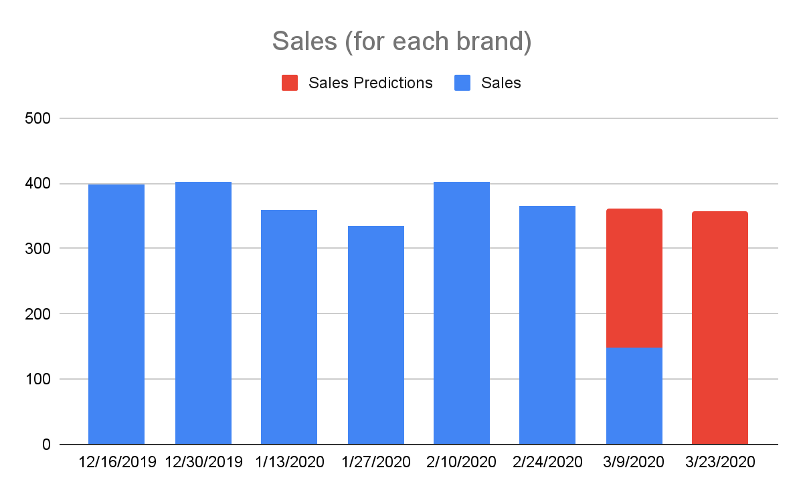
Results
For prediction we use the rate of growth sales and after we do the means of the rate.
r = -1.09%
Sales’ Prediction

Slide 18
DISCUSSION AND SOLUTION

Slide 19
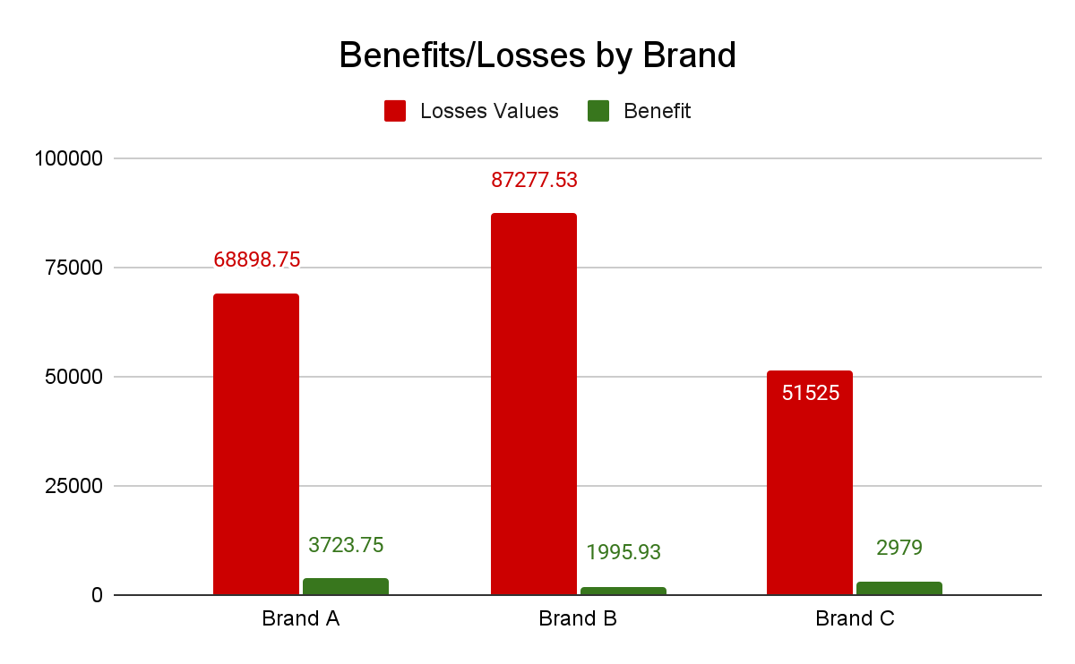
Discussion and Solution
This tables allow us to do a comparison between the lost level and the benefits level before any correction.
Ratio Benefit/Losses | 5.40% | 2.29% | 5.78%

Slide 20
Discussion and Solution
1. Michel must stop their orders for the next 23 days.
2. If Michel has constraints in the costs of orders ,it will be easier for him to do only one order per month. her volume will depend on our prediction with a security merge.we can take a merge security equal to 10% of sales.
3. If Michel haven’t constraints on her cost command he can decide to receive two orders per month but he will have to reduce the volume of his orders by around 53%.
Recommandations

Slide 21
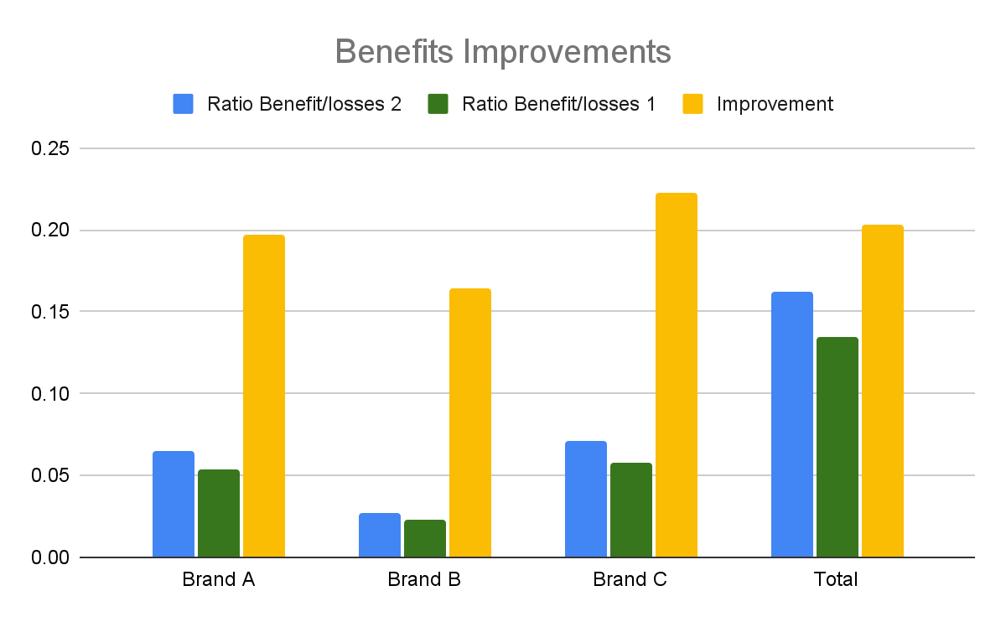
Discussion and Solution
4. Michel must sell 2 cans of tomatoes for a price of one.This will permit Michel to improve our benefit/losses rate by 20%.
Recommandations
With this strategy: “One brought, 2 offer for the price on one”.
Michel will be able to improve our benefits/losses rate..
And he will get a means improvement to 20%.

Slide 22
Discussion and Solution
5. If Michel wants to absorb the losses suffered, he can do 2 things:
A-If the customers are indifferent to the brand, Michel may decide to sell only the brand A boxes because he has a higher profit ratio on that brand.
And then it will take 5 years before completely absorbing her losses.
B-If the customers are not indifferent to the brand, Michel can decide to sell a combination of 3 brands in the same proportions and then it will take him around 6 years 6 months to absorb the losses.
Recommandations

Slide 23
Discussion and Solution
If The customers are indifferent to brands, Michel will take 5 years.
He will take between 5 and 6 years to absorb her losses.
Keep selling
If the customers are not indifferent to Brand, Michel will take 6 years before losses absorption.
Michel can choose to:
Stop selling
Michel will never absorb her losses.

Slide 24
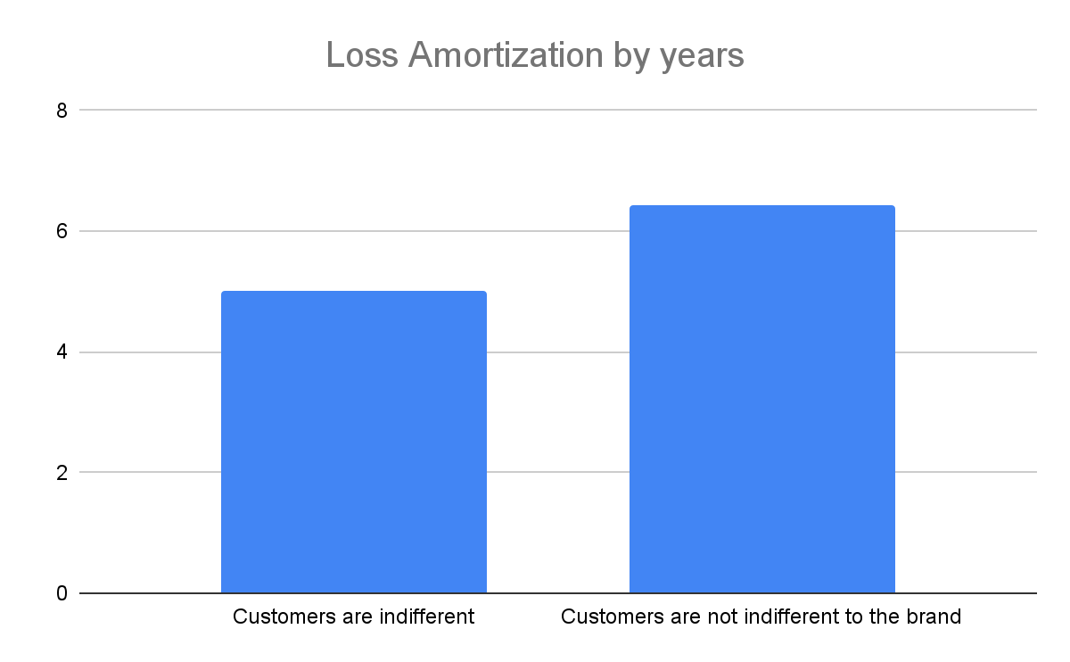
Discussion and Solution
Time to cover losses depends on the two scenario.

Slide 25
SWOT
STRENGTH | WEAKNESSES
Sells different brands of tomato paste. Have a sales and inventory register adapted to the context. | The products have a fairly short expiration date which reduces our reaction time. . Lack of knowledge of customer preferences.
OPPORTUNITIES | THREATS
This is the perfect opportunity for the company to adopt a new tomato paste inventory management strategy that is better suited to its situation. The boutique owner can adjust his stock to demand. Conduct a survey to know what the client really wants. Opportunity for michel's store to absorb all his debts on the sale of tomato paste in the coming years. | Any mistake in our management strategy can cause great loss and reduce our reaction time. Due to the fact that the store does not have a real knowledge of the customer's preferences, it is difficult for us to keep them.

Slide 26
REFERENCES AND APPENDICES
To do this work we have consulted:
The project submission templates
The BA Course
https://www.freshbooks.com/hub/accounting/what-is-fifo#:~:text=FIFO%20stands%20for%20%E2%80%9CFirst%2DIn,ones%20used%20in%20the%20calculation.

Slide 27
TEAM’S MEMBERS
Serginau LOUIS
Chrismond VERSAILLES
Hardiles THERMORIS
Chasnick DESIR

Slide 28
Thank You!

